Slide 1
Myntra Analysis Harish Kumar S

Slide 2
Introduction to Myntra
Myntra is a one stop shop for all your fashion and lifestyle needs. Being India's largest e-commerce store for fashion and lifestyle products, Myntra aims at providing a hassle free and enjoyable shopping experience to shoppers across the country with the widest range of brands and products on its portal. The brand is making a conscious effort to bring the power of fashion to shoppers with an array of the latest and trendiest products available in the country
Myntra Mission Statement
Use technology to democratise fashion & lifestyle and help people look good.

Slide 3
Myntra Business Model
As an online marketplace , Myntra facilitates the sale of fashion items by third-party vendors. Revenue for the firm comes mostly from the transaction fees paid by suppliers since it is a marketplace service provider. Logistics, advertising, and consulting are some of its other revenue generators. Products sold by Myntra under its brand are also available for purchase.
Customers looking for both well-known brands and new trends were drawn to this variety. In 2014, Flipkart made strategic move by acquiring Myntra for over $300 million.
Myntra, a leading Indian fashion and lifestyle e-commerce platform, operates primarily on a B2C Business-to-Consumer model. Here are the key aspects of Myntra's business model
eCommerce technology are all parts of Myntra's business model. These methods have kept customers coming back for more. The product variety of Myntra was enhanced by collaborations with over 6,000 lifestyle and fashion companies, including Levi's, H&M, Biba, Nike, Mango, Hilfiger, and many more.

Slide 4
Market Postion and Growth
Myntra is India's largest fashion e-commerce player, with a market share estimated to be between 35% and 45% as of 2023
Myntra's strong market position, owing to its growing customer base, domestic and international brand associations, world-class tech-led innovations and a strong foothold among the premium fashion-forward customers, has enabled its marketplace entity to turn EBITDA positive since the last quarter of CY 2023top competitors include Flipkart, Pepper fry, and Style Nook
Growth Trajectory Revenue:
Myntra's operating revenue in 2023 was 43.75 billion Indian rupees, which was an increase from the previous year.
Monthly active users: Myntra's monthly active users (MAUs) increased by 33% from 45 million in 2021 to 60 million by the end of 2023.
Catalog size: The catalog size on the platform has grown by over 50% in the last year.
International brands: Myntra has over 400 international brands in its portfolio, including Mango, H&M, and Tommy Hilfiger.
End of Reason Sale: In 2023, over 20 million users participated in Myntra's annual sale event, End of Reason Sale (EORS).
Expansion: Myntra is expanding into non-metro cities, and has been gaining market share across all categories.
Profitability: Myntra has been operationally profitable since October 2023

Slide 5
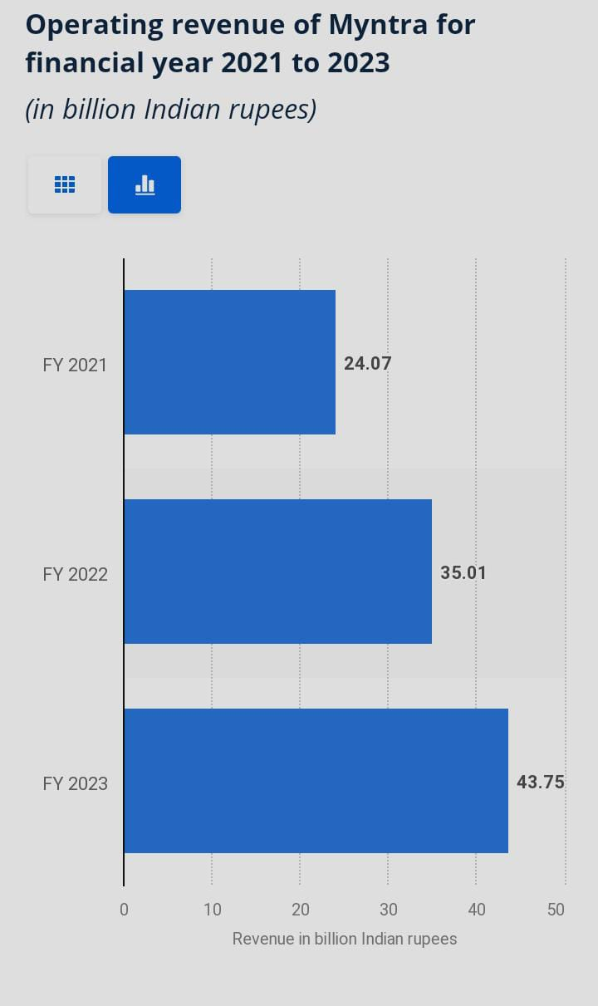
Myntra revenue model 2022 - 2023
Total operating revenue Myntra's operating revenue for the financial year 2022 - 2023 was 43.75 billion Indian rupees which was a 25% increase from the previous year
Product sales Myntra's gross sales in 2022- 2023 : 323.7 billion INR.
Product sales contribution to operating revenue 739.5%Myntra revenue model 2022 23

Slide 6
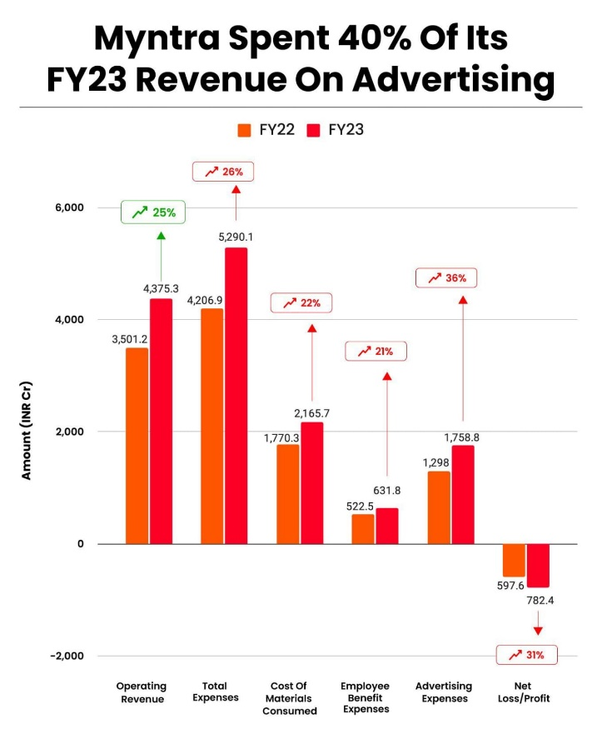
Myntra product advertising
2022 – 2023 revenue : Myntra's advertising and promotional expenses were INR 1,758 crore
Contribution to operating revenue In the financial year 2023 40% of the company's operating revenue.

Slide 7
Membership & Market Place Revenue
Membership Revenue and subscription plans
Myntra's membership revenue, which comes from its loyalty programs and subscription services of 2023 ₹590 crore (or ₹5.90 billion).
Myntra’s marketplace revenue, which is derived from commission fees and other charges related to third-party sellers on its platform of 2023 ₹3,370 crore (or ₹33.70 billion)
Growth 31.7% increase from the previous year
Total Operating Revenue 49.60 INR
Summary of revenue contribution
Marketplace Revenue: ~67.9%
Marketplace Revenue: ~67.9%
Product Advertising and Other Revenue: ~20.2%

Slide 8
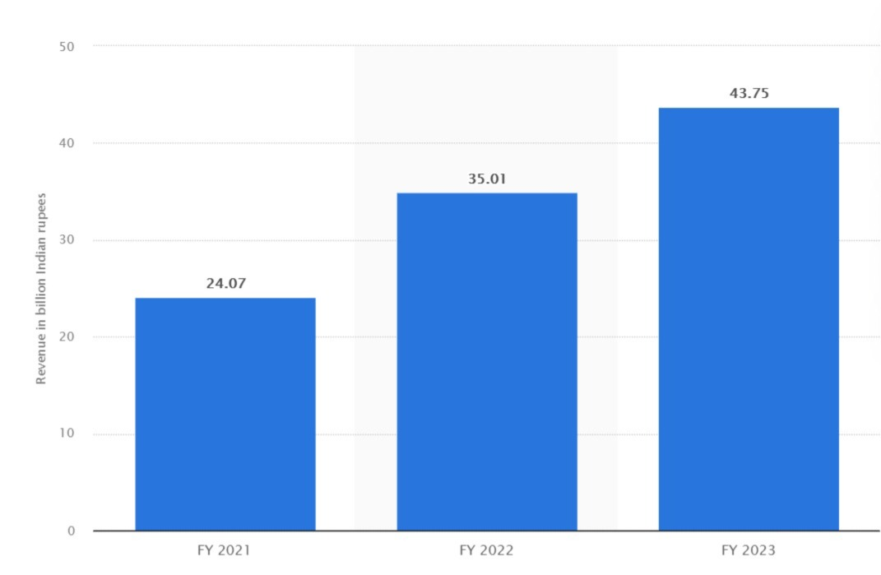
Operating revenue of myntra of financial year 2021-2023

Slide 9
comparable online store of myntra.com Fashion and Appare in india
Most Visited Fashion and Apparel Websites in India
List of myntra.com competitors
ajio.com , with 21.45M visits, 79 authority score, 55.96% bounce rate
meesho.com , with 30.45M visits, 75 authority score, 50.96% bounce rate
tatacliq.com , with 7.78M visits, 64 authority score, 63.96% bounce rate
etsy.com , with 406.25M visits, 99 authority score, 46.14% bounce rate
nykaa.com , with 12.06M visits, 75 authority score, 59.44% bounce rate
flipkart.com , with 217.72M visits, 97 authority score, 51.98% bounce rate
jiomart.com , with 12.81M visits, 73 authority score, 52.21% bounce rate
Last updated: September 11, 2024
Rank | Website | Category
1 | myntra.com | Lifestyle > Fashion and Apparel
2 | ajio.com | Lifestyle > Fashion and Apparel
3 | wishlink.com | Lifestyle > Fashion and Apparel
4 | nykaafashion.com | Lifestyle > Fashion and Apparel

Slide 10
Technology utilization
Cloud services
Myntra leverage technologies Microsoft Azure's cloud platform to power its digital transformation and enhance the customer experience
utilization of myntram for data analytics and for storage of dataproc for processing
Impact of technology
Enchances operating efficiency and supports largescale dats processing
Enables personalized customer experiences and realtime analytics

Slide 11
“Technology has and will continue to enable innovative and engaging experiences to consumers, especially in the online fashion sector. Myntra is the market leader and has an inspiring mission to democratize fashion through technology”
-Raghu Krishnananda chief technology officer

Slide 12
Data Analytics and Personalization
Customer Insights:
analytics team analyzes customer data to understand their fashion preferences and uses this information to curate personalized collections of products for each customer.
Uses data for tagered marketing and personalized product recommendation
Personalization straegies:
technological infrastructure leveraging artificial intelligence and data analytics to personalize user experiences, recommend products, and optimize supply chain management

Slide 13
Customer sentiment analysis using the social media
Customer review analysis
Understand how customers perceive Myntra through social media and reviews Instagram, youtube and facebook
Categorized reviews into positive, negative, neutral impact
Positive: The ad has garnered some positive feedback for its visual appeal and the attractiveness of its featured individuals. It has succeeded in catching the attention of viewers who appreciate the aesthetics or have specific interests.
Negative: The primary concerns revolve around Myntra's perceived failure in customer service and product quality, as well as possible cultural insensitivity. These criticisms highlight significant issues that could affect the brand’s reputation.
Neutral: Many comments fall into the neutral category, seeking specific details or expressing personal preferences without significant critique of the ad itself.

Slide 14
Positive impact cosumer comments
Exceptional Variety and Quality
“Myntra offers an incredible range of products with a focus on quality. I recently purchased a stunning dress that exceeded my expectations. The fabric was top-notch and the design was exactly as shown online. Highly recommend for anyone looking for stylish options!”
Fast and Reliable Delivery
“Myntra’s delivery service is impressive! My order arrived well within the promised time frame and the packaging was secure. The convenience of getting my fashion fix delivered right to my doorstep is unbeatable.
User-Friendly Website and App
“The Myntra app and website are easy to navigate, making the shopping experience seamless. I can quickly find what I’m looking for, and the detailed product descriptions help in making informed choices.”
Stylish and Trendy Collections
“I love Myntra’s collection of trendy and fashionable clothes. Whether it's for casual wear or special occasions, they have something for every style. Their seasonal collections are always on point!”
Excellent Customer Care Follow-Up
“Myntra’s follow-up after a purchase shows their commitment to customer satisfaction. I received a call to ensure that my order met my expectations, which was a nice touch and made me feel valued.”
“

Slide 15
Negative impact cosumer comments
Frustrating Return Process
"I've had an extremely disappointing experience with Myntra. I received a product that was not only incorrect but also used. Despite providing evidence, including an unboxing video, Myntra refused to process the return. Their customer service is unresponsive and ineffective. Avoid if you value your time and money."
Poor Quality Products
"Ordered a kurta that arrived in a terrible condition—torn and stinking. Myntra's customer service denied my request for a refund, claiming the product was as described. This is unacceptable. Their quality control is seriously lacking."
Refund Issues
"Myntra's refund policy is a joke. I returned a product over a month ago, and despite numerous follow-ups, I haven't received my money back. Their customer support is unhelpful and does not provide any resolution."
Quality Concerns
"I bought a dress from Myntra that was supposed to be high-quality but fell apart after just one wash. Their products are not worth the price, and their customer service does not help with returns or exchanges."
Unacceptable Delivery Delays
"I've been waiting for my Myntra order for over a week, with the status constantly stuck on 'out for delivery.' Customer care representatives offer no real solutions, just empty promises. This level of service is unacceptable."

Slide 16
Neutral impact of customer comments
Delivery Timeliness: Delivery times can vary. Some customers report receiving their orders promptly, while others experience delays, especially when tracking shows items as 'out for delivery' for extended periods.
Customer Service: Customer service experiences are mixed. Some users find the support helpful, while others feel that responses are automated and lack resolution, particularly regarding issues with refunds and returns.
Return Policy: Myntra’s return policy is straightforward but can be restrictive. There are occasional issues with processing returns, and some items are marked as non-returnable
Order Issues: There are occasional reports of discrepancies between the ordered and delivered products, which can be frustrating. Ensuring thorough checks during order fulfillment could improve customer satisfaction.
Product Quality: The quality of products is generally good, but there are occasional reports of receiving items that do not match the description or are of lower quality than expected

Slide 17
Competitive analysis
Competitors
Flipkart, Amazon India, Ajio (Reliance Retail), Tata Cliq
Competitive Factors
Product Range and Variety
Pricing Strategy
Customer Service
Brand Partnerships
competitive advantages
Strong Brand Portfolio
Extensive Product Range

Slide 18
Market trends identification for myntra.com
Customer Service and Experience
Product Quality and Transparency
Return and Refund Policies
Pricing and Value for Money
Technological Integration

Slide 19
Strategic recommendations
Enhance Customer Service and Support
Improve Response Times: Accelerate response times for customer queries and complaints. Implement advanced customer support systems like AI-driven chatbots to handle common issues and streamline the resolution process.
Improve Complaint Handling: Address issues related to product delivery and returns more effectively. Implement a more transparent and accountable complaint resolution process to rebuild trust.
Revise Return and Refund Policies
Simplify Returns: Make the return process more user-friendly and less cumbersome. Consider extending the return period and simplifying the steps required for returns.
Refund Timeliness: Speed up the processing of refunds and ensure customers are updated regularly about the status of their returns.
Focus on Quality Assurance
Product Quality Checks: Strengthen quality checks to ensure that products meet customer expectations. Regularly review vendor performance to avoid issues like delivering incorrect or used items.
Transparency in Product Information: Provide accurate and detailed product descriptions, including sizing charts and material details, to reduce discrepancies between customer expectations and received products
Address Pricing and Discounts
Value for Money: Reassess pricing strategies to offer better value for money. Regularly evaluate competitive pricing and adjust strategies to stay attractive to price-sensitive customers.
Targeted Discounts: Utilize customer data to offer personalized discounts and promotions, enhancing customer engagement and conversion rates.
Strengthen Logistics and Delivery
Optimize Delivery Network: Enhance logistics efficiency by optimizing delivery routes and partnering with reliable courier services. Improve tracking systems to provide real-time updates to customers.
Expand Delivery Areas: Consider expanding delivery coverage to underserved or remote areas to reach a broader customer base

Slide 20
Leverage Technology for Personalization
AI and Data Analytics: Invest in advanced data analytics and AI to provide more accurate personalized recommendations and tailored shopping experiences.
Virtual Try-Ons: Continue to develop and promote virtual try-on technologies and AR features to improve customer confidence in their purchases.
Increase Transparency and Build Trust
Clear Communication: Clearly communicate product availability, pricing, and delivery times. Ensure customers are well-informed at every stage of their purchase journey.
Address Scams and Fraud Concerns: Implement measures to detect and prevent fraudulent activities and address any issues related to customer complaints about scams.
Expand Omnichannel Presence
Integrate Online and Offline Experiences: Enhance the integration between online and offline channels, such as improving the buy-online-pick-up-in-store (BOPIS) experience and enabling returns at physical stores.
Leverage Flipkart Synergy: Utilize synergies with the Flipkart Group for cross-promotion and shared resources to enhance the overall customer experience.
Innovate Marketing Strategies
Influencer Collaborations: Expand partnerships with influencers and celebrities to reach new audiences and drive engagement. Focus on collaborations that resonate with target demographics.
Interactive Campaigns: Create more interactive and engaging marketing campaigns that encourage customer participation and feedback.
Address Customer Feedback Proactively
Feedback Mechanisms: Implement robust mechanisms for collecting and analyzing customer feedback. Use this feedback to make continuous improvements and address recurring issues.
Act on Negative Feedback: Prioritize and address negative feedback related to product quality, customer service, and delivery. Publicly acknowledge and respond to feedback to show commitment to improvement.

